Slide 1

2025 UBS Finance Challenge ~ Pair Trade Stock Pitch
Region：Hong Kong Stock Market
Sector：Industrial ( Automobile)
Prepared by Team of AlphaStock
Mr. Wen Jie (Menger)
The Chinese University of Hong Kong, Shenzhen (May 2027)
Mr. Fang Mingxiang (Jack)
Macalester College, USA ( May 2028 )

Slide 2


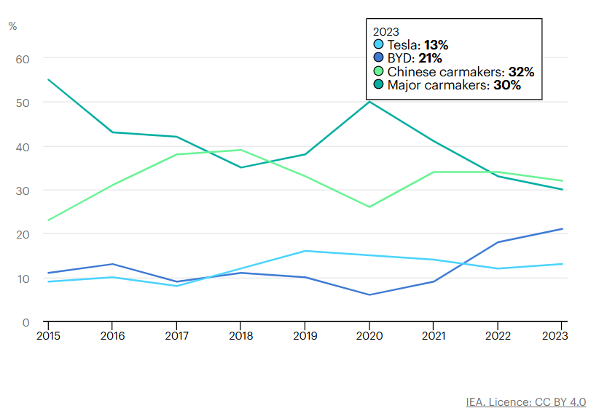
Overview of the EV Market and Pair Trade Concept and Key Assumption
Nearly one in five cars sold in 2023 was electric
BYD has over 30 industrial parks in China, the United States, Canada, Japan, Brazil, Hungary, and India. Its new energy vehicle footprint now covers 6 continents, over 70 countries and regions, and more than 400 cities

Slide 3
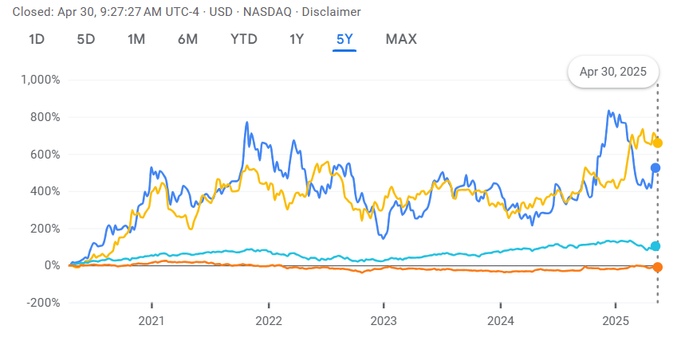


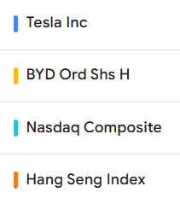
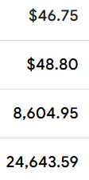
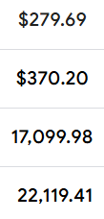
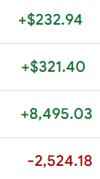
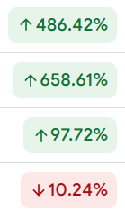
Past Five-year Trend of Pair Stock Prices vs. Index
5-yr Growth %

